Slide 1
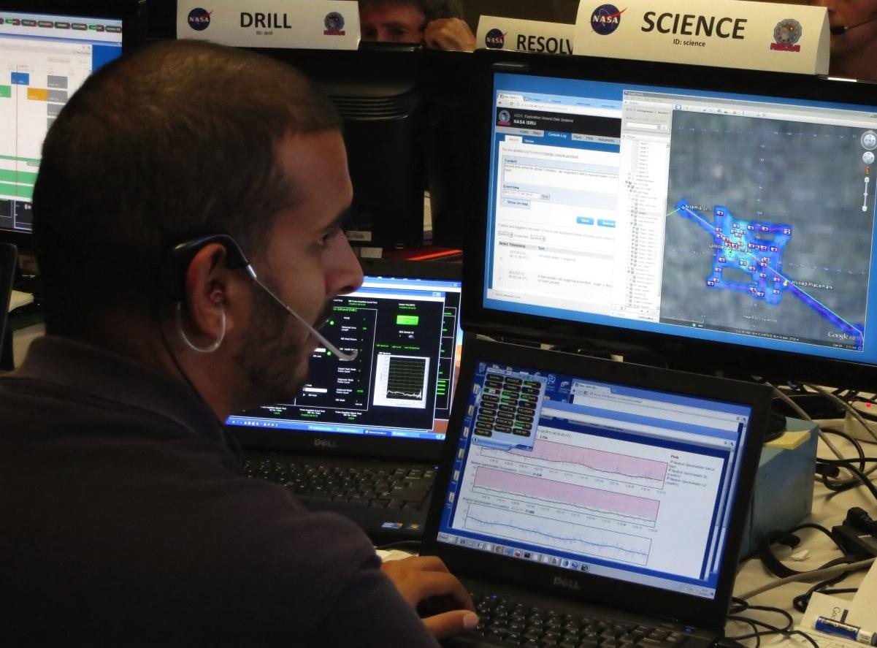


xGDS Exploration Ground Data Systems: Software tools for human and robotic exploration
Intelligent Robotics Group
NASA Ames Research Center

Slide 2
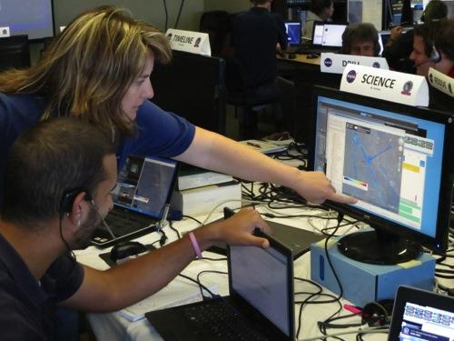
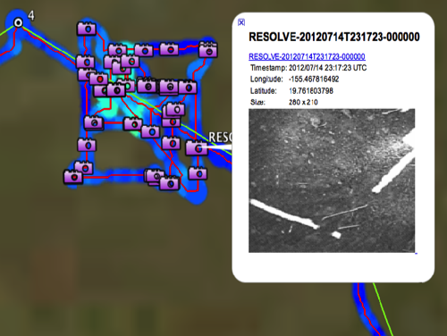
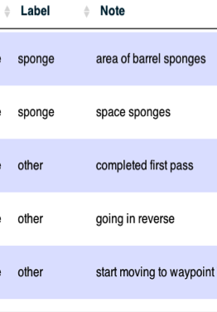
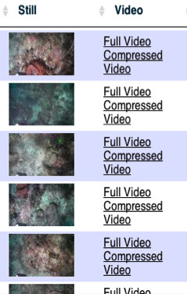
xGDS Phases
Plan
Monitor & Archive
Explore
Pre-Mission
During Mission
Post-Mission

Slide 3
xGDS Phases
Plan
Monitor & Archive
Explore
Import and organize a priori map data
Share map layers between users
Author map content
Create traverse plans for exploration
Use archived xGDS data to inform planning
Manage schedule of planned traverse execution
See live streams of all data
Take geolocated notes
See notes that others have taken
See live position and tracks in a map
Customize views of live data
See live streams of all data
Search xGDS data archive
Browse data table
Browse maps of operations
Watch archived video
Visualize plot of data
Export data
Correlate disparate types of data
Notes:
Give one example of each.
Planning: Scientists annotate a map to create a traverse plan.
Monitor & Archive: Scientists watch live streams of all data and take notes.
Exploration: Search the archive for a particular data.

Slide 4
xGDS Phases
Plan
Monitor & Archive
Explore
Import and organize a priori map data
Share map layers between users
Author map content
Create traverse plans for exploration
Use archived xGDS data to inform planning
Manage schedule of planned traverse execution
See live streams of all data
Take geolocated notes
See notes that others have taken
See live position and tracks in a map
Customize views of live data
See live streams of all data
Search xGDS data archive
Browse data table
Browse maps of operations
Watch archived video
Visualize plot of data
Export data
Correlate disparate types of data

Slide 5
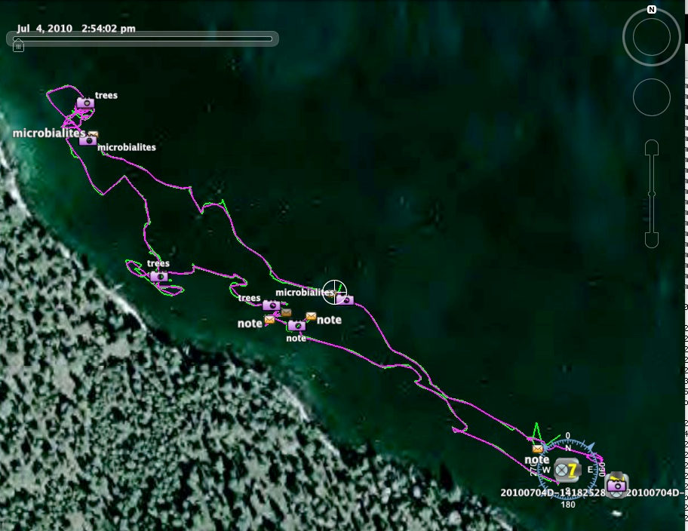
Monitor: Live Track
Notes:
Live tracks and ROV position can be seen in a map.
Position and track telemetry is transmitted efficiently.
Map rendering is done on the user's computer.
We also have integration with Google Earth via KML exports and network links.

Slide 6
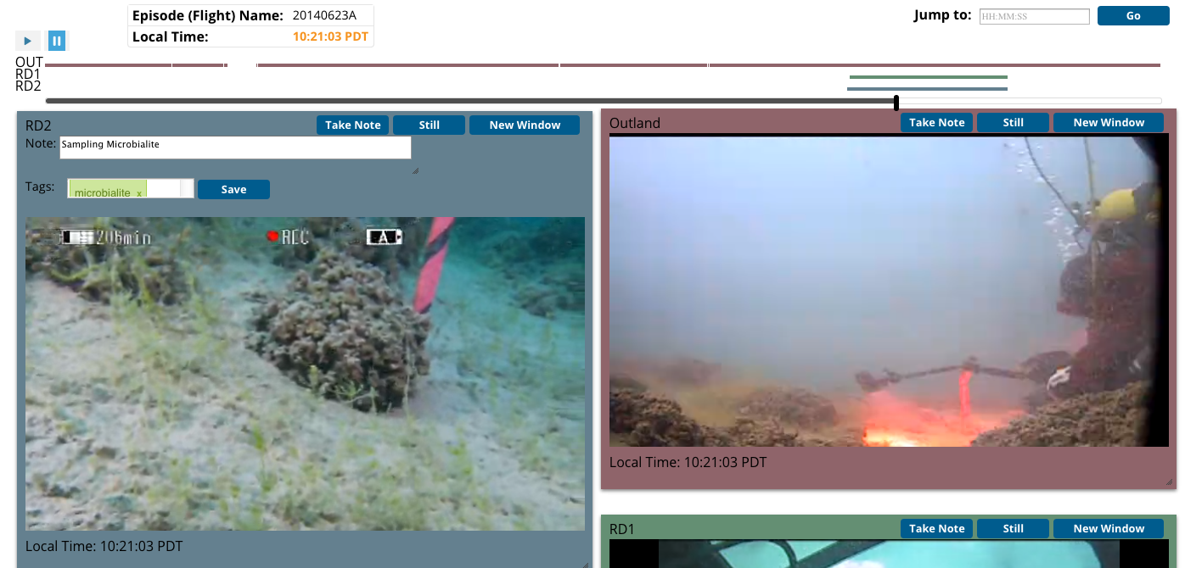
Monitor & Archive: Video
Notes:
Users take notes and create tags on live or recorded video.
- When user takes a note, we store “event time” in UTC, which is a time when at which video was taken.
- Time zone of the video source
- Creation time of the note
- Author
xGDS video system handles dropouts .
Users watch multiple synchronized videos simultaneously.
One control panel drives all of the videos.
Users can resize and move video displays to customize the layout

Slide 7
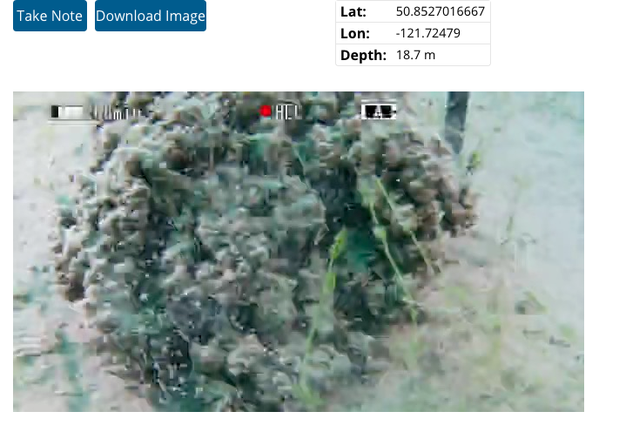
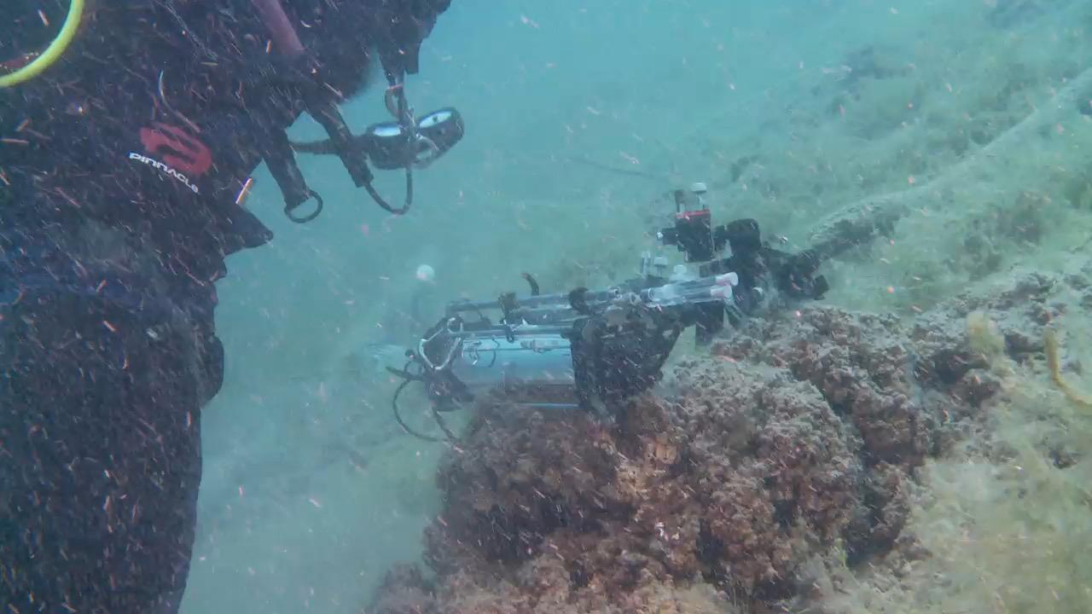
Monitor: Still from Video
Notes:
Users can take a still image from video.
Users can download still image files.
Image files include exif header with position and depth.
Users can take geolocated notes on images.

Slide 8
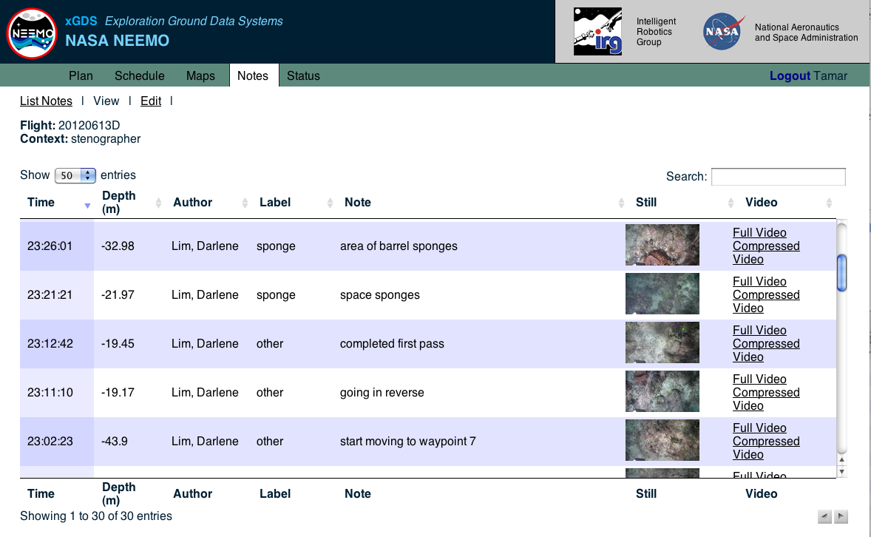
Explore: Notes
Notes:
Browse and search notes.
Sort and filter results
Notes are correlated with locations, imagery and video or other data.
Since we have tracking gathered (by time) from the NMEA inputs, we geolocate the notes and the video.

Slide 9
Backup Slides

Slide 10
xGDS Open Source Status
Approved for Open Source distribution by NASA
Apache license
Just deployed on GitHub
we are now using GitHub to support in-house development
Limited documentation
A topic for our support discussion…

Slide 11
Strategic Data Producers
Tactical Data Producers
External Vector Maps
Geologic Maps
Comm Coverage
Gigapan Voyage
MMSEV Data
EVA IS Data
xGDS
importer
importer
importer
importer
importer
importer
custom
python
Python/Django
MySQL
static
HTML
comm layers
data catalog
maps
apache
Mission Management Team
Tactical Science Ops
Strategic Science Ops
Google Earth
Web Browser
Google Earth
Web Browser
Google Earth
Web Browser
Google Earth
Web Browser
Google Earth
Web Browser

Slide 12
Video Hardware Architecture
Hardware
Compressor
(Teradek)
Shore Server
Boat Server
ROV
Camera

Slide 13
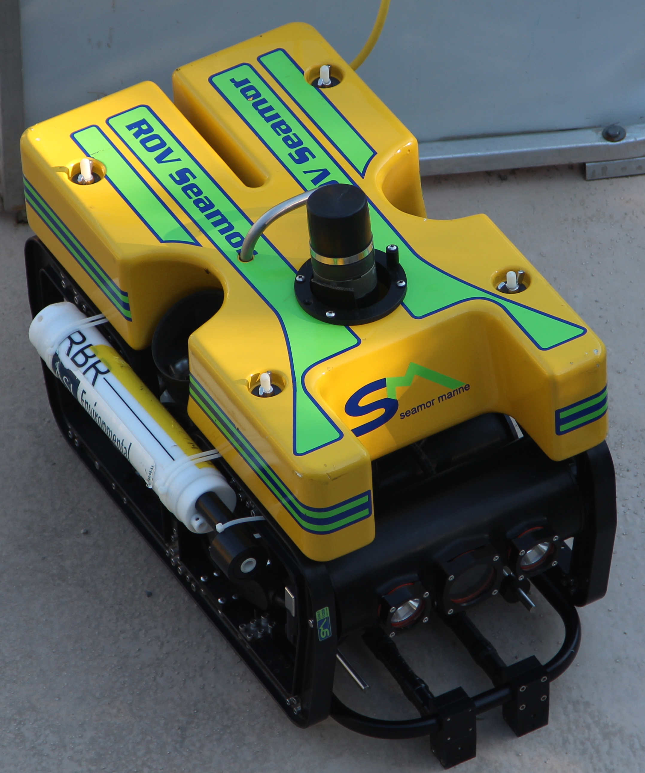
Video Hardware Architecture
Few users
Webserver
Boat Server
RTSP
Process Manager
(Pycroraptor)
HW Compressor
(Teradek)
Video Recorder
(VLC)
Segmenter
(LibAV)
File System
Camera
Notes:
What is the best way to represent pycroraptor

Slide 14
Video Hardware Architecture
Many users
RTSP
Webserver
Shore Server
Process Manager
(Pycroraptor)
HW Compressor
(Teradek)
Video Recorder
(VLC)
Segmenter
(LibAV)
File System
Camera
Notes:
What is the best way to represent pycroraptor

Slide 15
Video Hardware Architecture
Continuous data syncronization between two servers
Webserver
Boat Server
Webserver
Shore Server
Process Manager
(Pycroraptor)
Process Manager
(Pycroraptor)
Video Sync
Video Recorder
(VLC)
Video Recorder
(VLC)
Segmenter
(LibAV)
File System
Segmenter
(LibAV)
File System
Database Sync
Notes:
DB is synchronized continuously depending on bandwidth. Video is synchronized at the end of video collection or when there is bandwidth; shore server video is replaced with boat server video. Boat video is the best copy and is never replaced with shore video. Maybe have 2 arrows with bidirectional DB sync and one-directional video sync.

